Slide 1
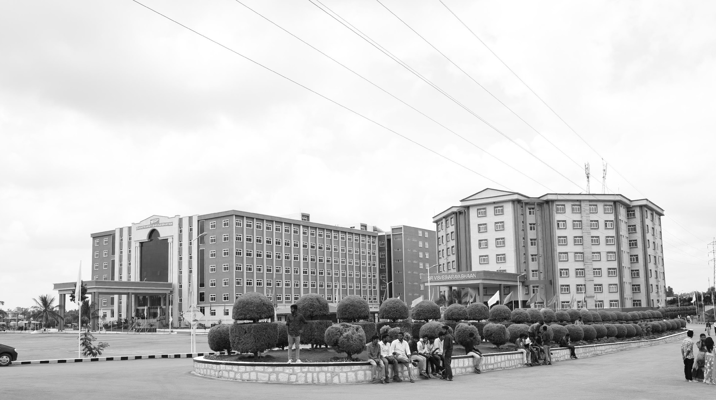

Gesture Driven Unmanned Vehicle
AY 2021-25
GITAM UNIVERSITY
Major Project
Project ID: CS8
A University should be a place of light, of liberty, and of learning.
Department of Electrical Electronics and Communication Engineering
Project Team:
Kumpati Rakesh
Sandhya Kuram
Nunna Karthikeyan
Project Mentor:
Dr K Koshy George
www.gitamedu.com

Slide 2


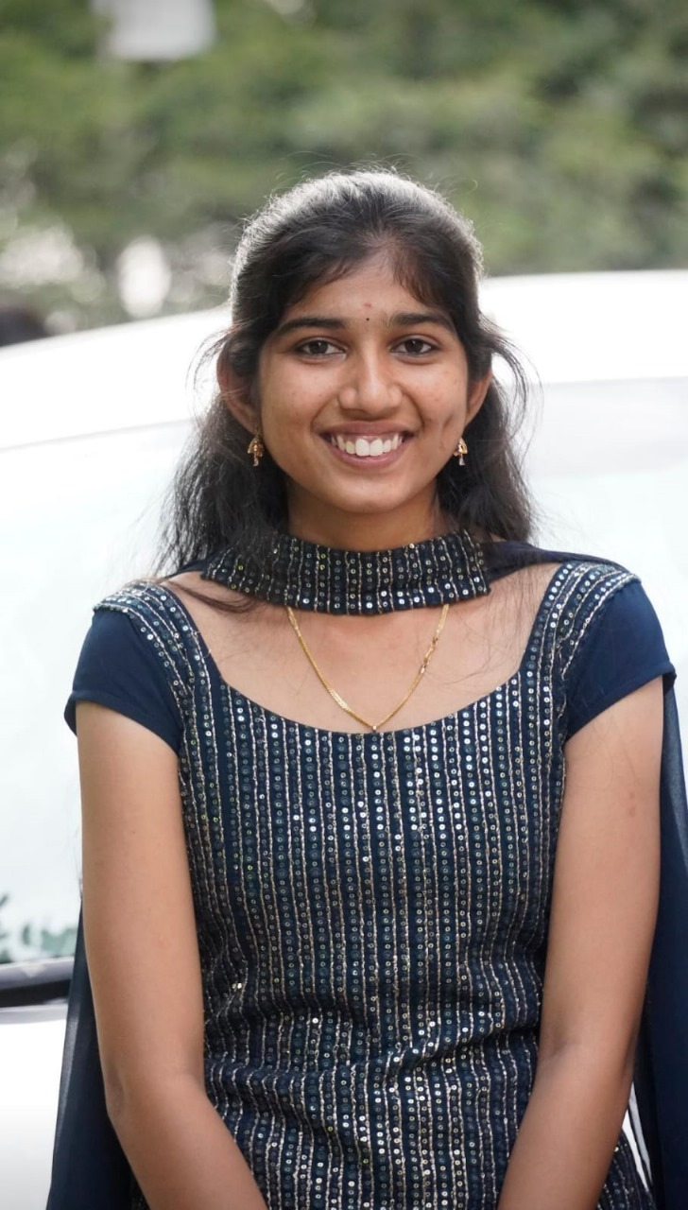

Project Group – Details
Photo
Track
Roll No
Name
EECE AI/ML
BU21EECE0100506
Kumpati Rakesh
EECE AI/ML
BU21EECE0100165
Sandhya Kuram
EECE AI/ML
BU21EECE0100478
Nunna Karthikeyan

Slide 3
Objective and Goals
Objective
The objective of developing hand gesture-driven unmanned vehicles using machine learning techniques is to create an intuitive and efficient control interface that enhances human-robot interaction. By leveraging hand gesture recognition, these systems aim to facilitate seamless communication between users and unmanned aerial vehicles (UAVs) or unmanned ground vehicles (UGVs), allowing operators to issue commands through natural hand movements rather than traditional input devices like joysticks or keyboards. This approach not only simplifies the control process but also improves operational effectiveness in dynamic environments, such as search and rescue operations, where quick and accurate responses are critical. Advanced machine learning models, particularly deep learning algorithms, are employed to interpret hand gesture data in real-time, translating user intentions into precise vehicle manoeuvers. This optimization enhances the performance and responsiveness of autonomous systems across various applications, making them more accessible and user-friendly.
Goals
Main Goals
Real-Time Gesture Recognition
Enhanced Control Interface
Operational Efficiency

Slide 4
Project Plan
Current Semester: Learning Algorithms
Task | Duration | Start Date | End Date
Learn machine learning algorithms for gesture data | 4 weeks | Week 1 | Week 4
Implement algorithms on hand gesture datasets | 4 weeks | Week 5 | Week 8
Compare algorithm accuracy in classification | 2 weeks | Week 9 | Week 10
Added more algorithms and changed datasets | 4 weeks | Week 11 | Week 14
Next Semester: Functional Prototype & Vehicle Integration
Task | Duration | Start Date | End Date
Select a vehicle for the project | 2 weeks | Week 1 | Week 2
Implement functional prototype | 4 weeks | Week 3 | Week 6
Integrate signal reception and commands on vehicle | 4 weeks | Week 7 | Week 10
Add more hand gestures for additional commands | 3 weeks | Week 11 | Week 13
Final testing and adjustments | 2 weeks | Week 14 | Week 15

Slide 5
Literature Survey
LINKS:
https://developers.googleblog.com/en/drone-control-via-gestures-using-mediapipe-hands/
https://ieeexplore.ieee.org/document/8367759
https://www.researchgate.net/publication/359583277_Hand_Gesture_Recognition_for_Drone_Control
https://www.ijnrd.org/papers/IJNRD2305495.pdf
GITHUB help:
https://github.com/kinivi/tello-gesture-control
PDFs:
2018_hadri_soubhi_thesis.pdf
Hand_gesture_recognition_using_machine_learning_al.pdf
hgd.pdf
GhaziasgarDroneHandControl.pdf
HAND GESTURE DRONE.pdf
The above given links gets us to the papers or publication we went through.
We also saw other papers but these are more informative for our project.

Slide 6
Title | Author(s) | Year | Summary | Link
Hand Gesture Recognition for Drone Control | Mehrdad Ghaziasgar, James Connan, Reg Dodds | 2017 | This paper presents a gesture-based interface for controlling UAV drones using webcam input. The system detects, tracks, and recognizes the user’s hand shape to issue flight commands. It recognizes eight hand shapes and is robust to variations in test subjects. | ResearchGate
Hand Gesture Controlled Drones: An Open Source Library | Kathiravan Natarajan, Truong-Huy D. Nguyen, Mutlu Mete | 2018 | The study introduces a gesture-based drone control mechanism using a Parrot AR.Drone 2.0. The framework demonstrated a 0.90 accuracy rate using a cascaded AdaBoost algorithm on 8,302 images. Accuracy improves with closer proximity, better lighting, and higher-resolution cameras. | IEEE Xplore
Real-Time Human Detection and Gesture Recognition for On-Board UAV Rescue | Chang Liu, Tamás Szirányi | 2021 | The paper proposes a gesture recognition system for UAV rescue operations, detecting and tracking people while recognizing ten predefined gestures. It uses YOLO3-tiny for human detection and a deep neural network for gesture recognition, achieving 99.80% accuracy. Future work involves outdoor testing. | ResearchGate

Slide 7
Hand Gestures for Drone Control Using Deep Learning | Soubhi Hadri | 2018 | This system utilizes deep learning-based Single Shot Multi Box Detect (SSD) for hand detection, with gesture recognition done through image processing. It allows easy integration of new gestures without retraining and works with MAV Link-supported drones using Arduino pilot for communication. | Thesis PDF
UAV Manipulation by Hand Gesture Recognition | Shoichiro Togo, Hiroyuki Ukida | 2022 | This paper compares two methods for UAV control: the FB method, which uses color information and Fourier-transformed data, and the ML method using OpenPose and LSTM for gesture recognition. The FB method is accurate in specific conditions, but the ML method is more adaptable and robust across environments. | MDPI Sensors

Slide 8
Analysis - SWOT
Strengths
Weaknesses
W1. Limited Accuracy
W2. Environmental Sensitivity
W3. High Computational Requirements
S1. Intuitive Control
S2. Hands-Free Operation
S3. Increased Safety
S4. Versatility
Threats
Opportunities
T1.Privacy Concerns
T2. Market Competition
O1. Emergency Response and Rescue
O2. Healthcare and Assistive Robotics
O3. Education and Training
O4. Agriculture

Slide 9
Analysis – 4W1H
Why: To offer an intuitive, hands-free control method that enhances user experience and accessibility.
What: A vehicle controlled by human gestures for navigation and operation.
Where: Applicable in environments like hazardous areas, public spaces, or industrial settings.
When:Used when traditional controls are impractical or when hands-free operation is required..
How: Utilizes sensors to detect gestures and translate them into vehicle commands.
Refined Objective: To create a user-friendly, gesture-controlled vehicle for diverse applications, improving safety and efficiency.

Slide 10
Use Cases & Testing
Use Cases
Emergency Response: Control robots or drones to search and rescue in disaster zones, where hands-free and rapid response is critical.
Healthcare Assistance: Enable people with disabilities or mobility impairments to control assistive robots or wheelchairs with simple gestures.
Public Spaces: Manage unmanned vehicles for security surveillance or delivery services in airports, malls, or parks.
Test Cases
1.Gesture Recognition Accuracy
Test Case: Verify the accuracy of gesture recognition.
2. Response Time to Gestures:
Test Case: Measure the response time between gesture recognition and vehicle action.
3.Obstacle Detection and Avoidance:
Test Case: Ensure the vehicle detects and avoids obstacles

Slide 11
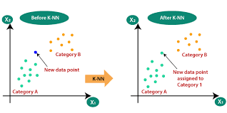
S
Implementation And Result
‌MACHINE LEARNING ALGORITHMS:
KNN
SVM
CNN
DECISION TREES
1. K-Nearest Neighbors (KNN)
Definition: A simple, non-parametric classification algorithm.
Type: Supervised
How it works:
Stores all training instances.
Classifies based on the majority class of K closest neighbors.
Use cases: Image classification, recommendation systems.
Pros: Easy to implement, intuitive.
Cons: Slow with large datasets, sensitive to irrelevant features.
Application: Classifies gestures based on features extracted from sensor data (e.g., accelerometer or gyroscope).
How it helps: Quickly identifies the closest matching gesture from the training set based on distance metrics.
‌MACHINE LEARNING ALGORITHMS

Slide 12

2. Support Vector Machine (SVM)
Definition: A supervised learning model used for classification and regression.
Type : Supervised
How it works:
Finds the hyperplane that best separates different classes.
Maximizes the margin between the closest points of classes.
Use cases: Text classification, image recognition.
Pros: Effective in high-dimensional spaces, robust to overfitting.
Cons: Less effective on very large datasets, sensitive to choice of kernel.
Application: Separates different gestures sing a hyperplane in feature space.
How it helps: Effectively distinguishes between complex gesture classes by maximizing the margin between different gestures.

Slide 13
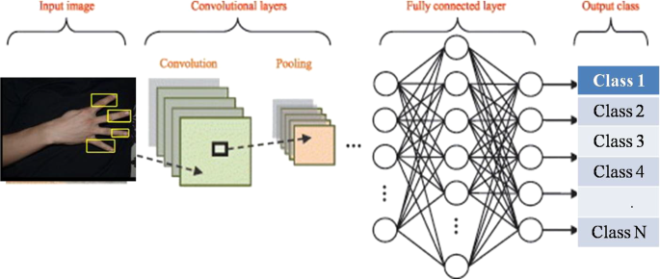
3. Convolutional Neural Network (CNN)
Definition: A deep learning model designed for processing structured grid data, like images.
Type : Supervised
How it works:
Uses convolutional layers to automatically detect features.
Pools features to reduce dimensionality and improve generalization.
Use cases: Image and video recognition, medical image analysis.
Pros: Excellent for image data, reduces need for manual feature extraction.
Cons: Requires a lot of data and computational resources.
Application: Processes image or video data of gestures.
How it helps: Automatically learns spatial hierarchies of features, making it excellent for recognizing gestures in images or video streams, especially in real-time applications.

Slide 14
4. Decision Trees:
Definition: A tree-like model used for classification and regression tasks.
Type : Supervised
How it works:
Splits data into branches based on feature values.
Each node represents a feature, and each branch represents a decision rule.
Use cases: Customer segmentation, credit scoring.
Pros: Easy to interpret, can handle both numerical and categorical data.
Cons: Prone to overfitting, sensitive to noisy data.
Application: Classifies gestures based on decision rules derived from features.
How it helps: Provides an interpretable model for gesture classification, allowing for straightforward adjustments and understanding of the decision-making process.

Slide 15
Contribution
Team Progress and Movement
Working on different types of algorithms week by week such as
K-Nearest Neighbours Method
Convolutional Neural Network
Decision Trees
Support Vector Machine
Individual Contribution
(1) Kumpati Rakesh
Helped in coding part
Used python for the project
(2) Nunna Karthikeyan
Found required datasets
Helped in understanding ML algorithms
(3) Sandhya Kuram
Researched several publictions and articles.
Executing ML algorithms

Slide 16
Conclusion & Future Work
Summary and Conclusion
The utilization of these techniques not only streamlines the control process but also enhances the vehicles' ability to respond to dynamic environments, such as those encountered in search and rescue operations. The project demonstrates the feasibility of using hand gestures as a natural and efficient means of controlling UAVs and UGVs, with experimental results showing significant improvements in operational effectiveness.
In conclusion, the project successfully illustrates the potential of hand gesture recognition combined with machine learning techniques to revolutionize the control of unmanned vehicles. By employing sophisticated models like CNNs, alongside KNN and SVM, the system can achieve high accuracy in gesture interpretation, facilitating seamless human-robot interaction. This approach not only simplifies the control mechanisms but also enhances the operational capabilities of unmanned vehicles in various applications, particularly in critical scenarios where rapid and intuitive responses are essential. Future work may focus on refining these algorithms further and exploring additional gestures to expand the system's versatility and effectiveness in real-world applications.
Future Work
We trained some hand gesture datasets with the machine learning algorithms and compared them for classification accuracy and in the future, we update the project by doing communication part with receiver from the transmitter hardware and software. We will choose a vehicle for receiving side and work with it.

Slide 17
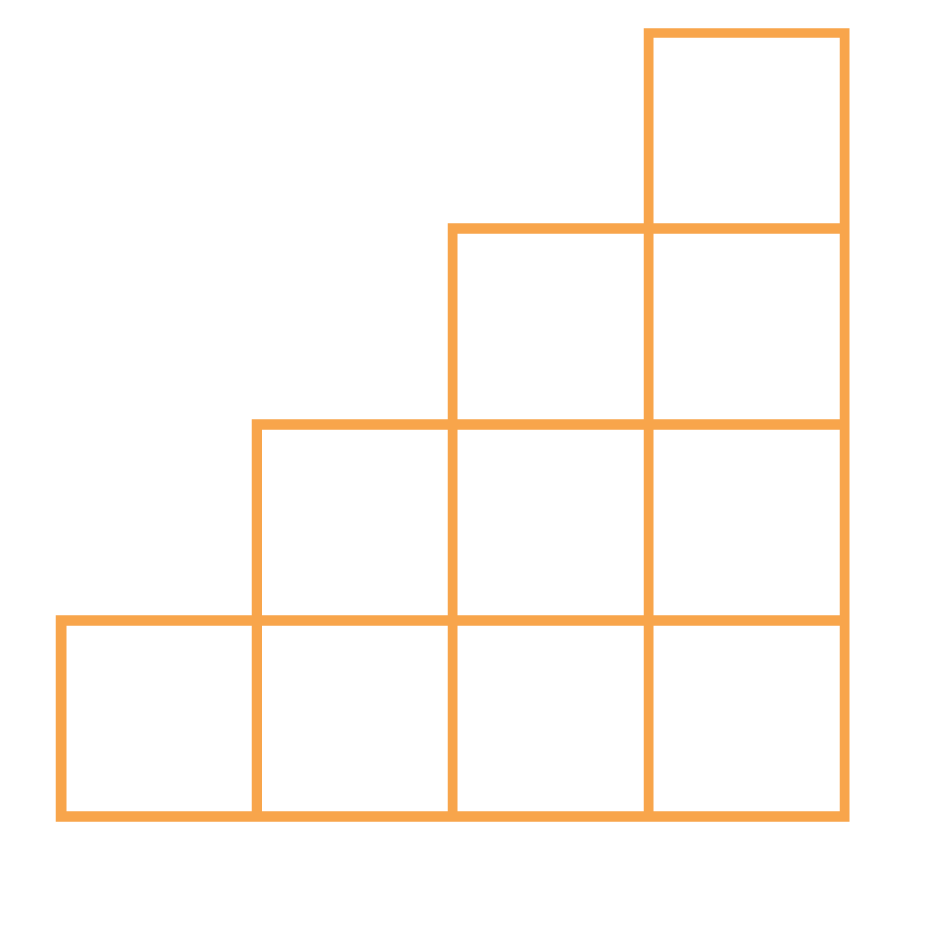
THANK YOU

